Slide 1
Move More Feel Good Physical activity for the body and mind
Name
Role and/or Qualifications
Organisation
On behalf of the LiveLighter team at Cancer Council WA
Notes:
Notes to presenter:
If you are in Western Australia or Victoria, you can order resources to give out to attendees. Please allow 3 weeks for delivery. Order using the online form - https://livelighter.com.au/order/resources
You can also download and print resources from this page - https://livelighter.com.au/toolbox/download-resources
The following resources are particularly relevant to this presentation:
https://cdn.livelighter.com.au/assets/resource/factsheet/ll-factsheet-get-active-(l3025d).pdf
https://cdn.livelighter.com.au/assets/resource/brochure/2022-get-active-and-move-more-dl.pdf
https://livelighter.com.au/toolbox/download-resources#exercise

Slide 2
Acknowledgement of Country
I would like to acknowledge the Traditional Custodians of the land on which we meet today.
I would also like to pay respect to the Elders past, present and emerging, and offer my acknowledgement and respect to other Aboriginal and Torres Strait Islander people who are present.
Notes:
Please include the name of the people on whose land you are gathered to the slide if this is known.
Find out what country you are on here: https://aiatsis.gov.au/whose-country-am-I

Slide 3
On the menu today
Benefits of being active
How much should I do?
Types of physical activity
Ways to be more active
Overcoming barriers
Free resources to help you move more
Photo by krakenimages on Unsplash

Slide 4
How physical activity impacts health and wellbeing
Notes:
Ask the group what are some benefits they know of or have experienced from being physically active

Slide 5
Benefits of being physically active
Physical wellbeing
Improves fitness and stamina
Builds muscle and bone strength
Increases mobility and flexibility
Weight management
Lowers blood pressure
Reduce your risk of chronic disease
Helps manage chronic diseases
Notes:
Note to presenter: There are many benefits of physical activity listed over this slide and the next and you don’t need to read them all out. Focus on those that would be of most relevance to your audience.

Slide 6
Benefits of being physically active
Mental wellbeing
Improves brain functioning
Better sleep
Reduces anxiety and depression
Improves self-esteem
Increases motivation
Improves mood
Increases energy
Sense of achievement
Social wellbeing
Reduces loneliness
Make new friends
Improves teamwork skills
Makes you feel more connected

Slide 7
Activity 1: What moves you?
Reflect and share with the group
In what ways are you already physically active?
Would you like to be more active?
Why would you like to be more active?
Notes:
Note to presenter: This activity can be done in different ways depending on the group size and dynamics e.g. talk in pairs, write down thoughts and then share as a group etc

Slide 8
How active should we be?

Slide 9
Move More: Be active on most, preferably all, days each week
Move Harder: Do 30-60 minutes of moderate or 15-30 minutes of vigorous activity (or equivalent combination) on most days
Move Stronger: Do muscle strengthening activities on at least 2 days each week
Move Often: Minimise the amount of time spent sitting and break up sitting as often as possible
Photo by Rinke Dohmen on Unsplash
Notes:
These are the official guidelines to aim for, however any extra bit of movement we can get into our day is a win for our health.
Strength exercises includes lifting weights, but also other things like picking up groceries or the kids, or doing a yoga class.
If you currently do no physical activity, start by doing some, and gradually build up to the recommended amount.
Note to presenter: These are the Australian physical activity guidelines for adults aged 18-64 years. If you are talking to an audience aged over 64 years encourage the inclusion of exercises for flexibility and balance as well.

Slide 10
Notes:
The guidelines recommend doing at least 30 minutes of moderate-intensity or 15 minutes of vigorous-intensity exercise each day – but what does that mean?
Exercise intensity can be split into three categories: light, moderate and vigorous-intensity. This can include play, exercise and chores.
Light-intensity activity involves a slightly higher level of energy than your resting state. While this type of activity isn’t included within the guidelines, it’s still good for your overall fitness and health. If you're doing light-intensity activity you'll be able to talk normally and your breathing rate won't increase. Examples include light stretching and walking at a slow pace.
Moderate-intensity exercises include brisk walking, leisurely swimming or bike riding, sports where a proportion of the time is spent standing around like cricket or volleyball and active housework like vacumming. Strength exercises like using free weights, own body weight exercises, yoga, pilates, rock climbing and carrying groceries or kids also count. If you're doing moderate-intensity exercise you'll be able to comfortably chat, but you won't be able to sing more than a few words without running out of breath.
Vigorous-intensity exercises include activities like circuit training, running or sprinting, walking up stairs or hills, highly-active sports like AFL, netball, soccer or tennis, vigorous forms of gym cardio (think the rowing machine or skipping) and moderate-intensity exercises performed more vigorously e.g. swimming for exercise, cycling fast or interval training. If you're doing vigorous-intensity activity you won't be able to say more than a few words without having to pause to breathe.

Slide 11
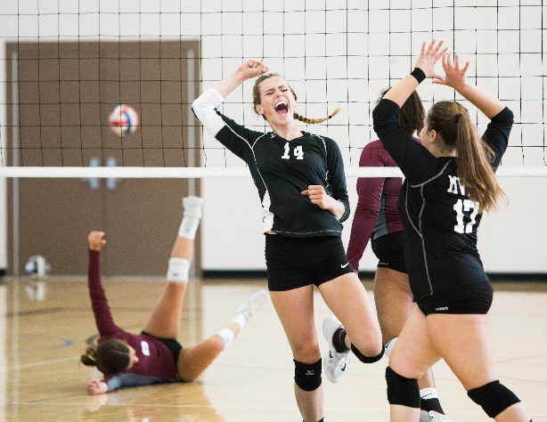
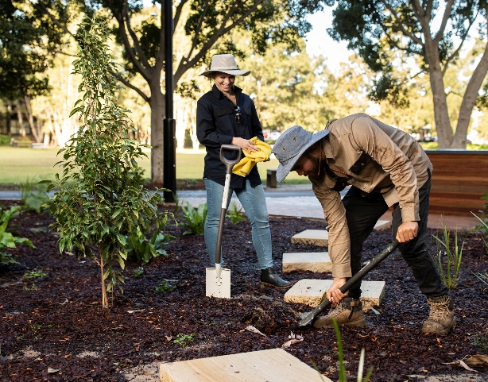
Types of physical activity
Deliberate exercise or sports
Running, playing a team sport, going to the gym, dance class
Incidental activity
Playing with kids, hanging out the washing, walking to the bus
Work-related activity
Climbing a ladder, lifting boxes, gardening
Photo by Vince Fleming on Unsplash
Photo by Pascal Treichler on Pixabay

Slide 12
Ways to be more physically active
At home
Gardening
House work
Playing outside with the family or pet
At home workouts
Going for a walk
Lounge room dance party!
At work
Going for a walk at lunch
Walking meeting
Standing desk
Park further away
Take the stairs
Take regular stretch breaks
On the weekend
Go for a bike ride
Gardening
Meet up with friends for a coffee and a walk
Go for a hike/long walk
Join a sports team

Slide 13
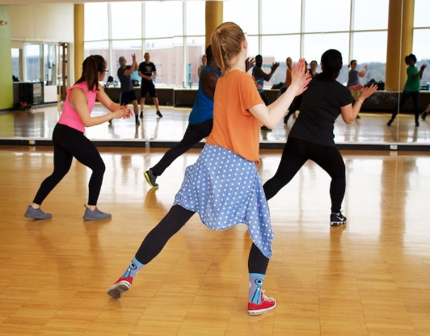
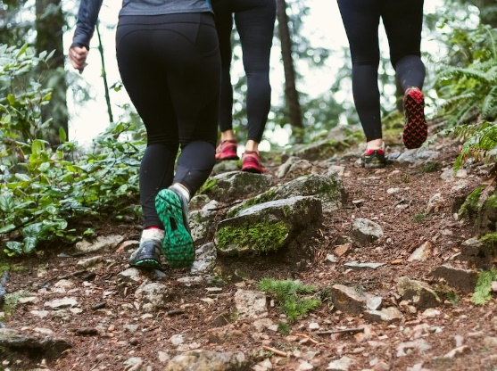
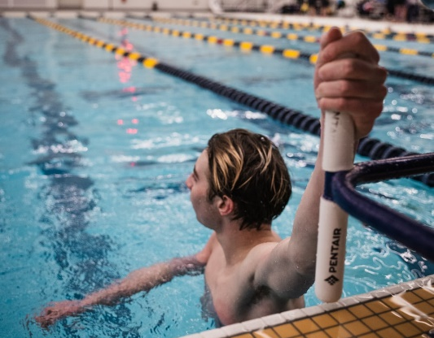
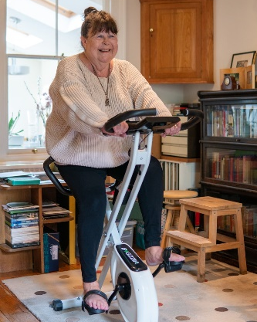
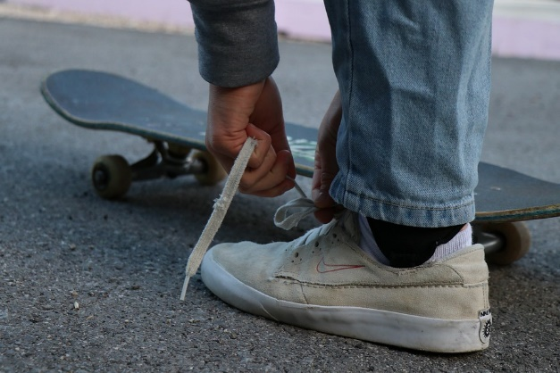
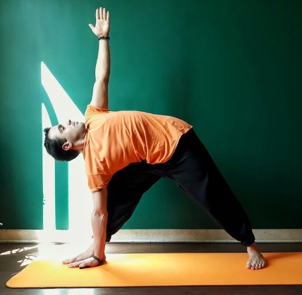
Find the joy in movement
Photo by Danielle Cerullo on Unsplash
Photo by Greg Rosenke on Unsplash
Photo by Jonah Brown on Unsplash
Photo by CAB on Unsplash
Photo by Markus Spiske on Unsplash
Photo by Alvin Balemesa on Unsplash
Photo by Lena Helfinger on Pixabay
Photo by Emad YOGI on Unsplash
Notes:
The key with being active is to find something we like doing. Some people like the gym, others prefer dancing. Life is to be enjoyed – and this applies to how we move our bodies as well.

Slide 14
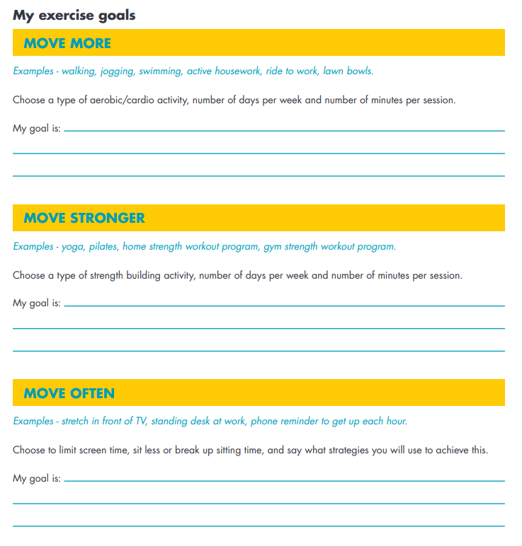
Activity 2: Find ways to move more
Reflect and share with the group
In what ways would you like to be more active in your everyday life?
Notes:
Note to presenter: If you have printed the ‘goal setting factsheet’ from the LiveLighter website, you can give these out at this point in the presentation.

Slide 15
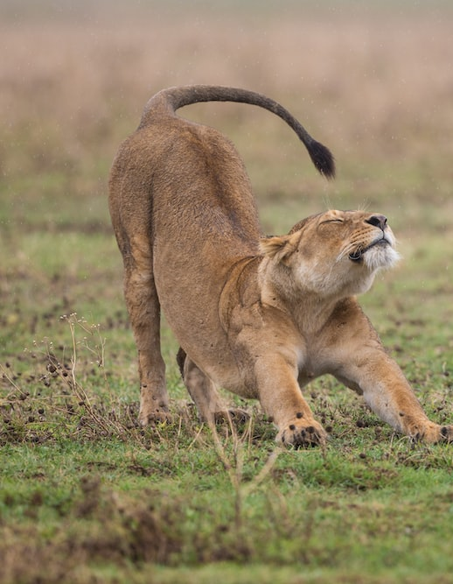
Stretch break!
Photo by jean wimmerlin on Unsplash

Slide 16
Overcoming barriers

Slide 17
Common barriers
Time restrictions
Fatigue and lack of energy
Low motivation
Difficulty getting started after a long period of inactivity
Financial restrictions
Cultural norms

Slide 18
Barrier | Possible solutions
Time restrictions | Build movement into your day e.g. take public transport to work, have active catch-ups with friends Make use of the small periods of time you do have available – 3 x 10 minutes stints = 30 minutes of exercise!
Fatigue/lack of energy | Start small e.g. aim for 5 minutes each day and build up from there Try low impact movement like stretching, yoga and Pilates
Low motivation | Invite a friend or family member to join Set yourself a challenge or goal Think about your ‘why’
Difficulty getting started after a long period of inactivity | Choose an activity that feels comfortable e.g. swimming, Don’t push yourself too hard. Experiencing pain or feeling like exercise is a chore might mean you need to build up more slowly.
Financial restrictions | Access free resources on the LiveLighter website Use YouTube videos – yoga, Pilates, HITT class Workout at home or at the park

Slide 19
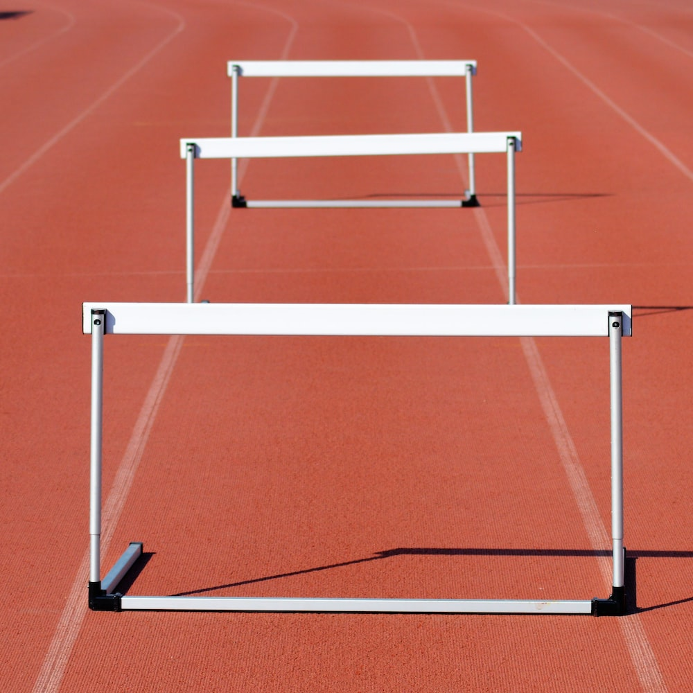
Activity 3: Breaking down barriers
Reflect and share with the group
What are your barriers to being more active?
What are some possible ways to overcome these?
Remember it won’t happen overnight, so take small steps first!
Photo by Interactive Sports on Unsplash
Notes:
Note to presenter: Identify any themes that are common across group members e.g. lack of time.

Slide 20
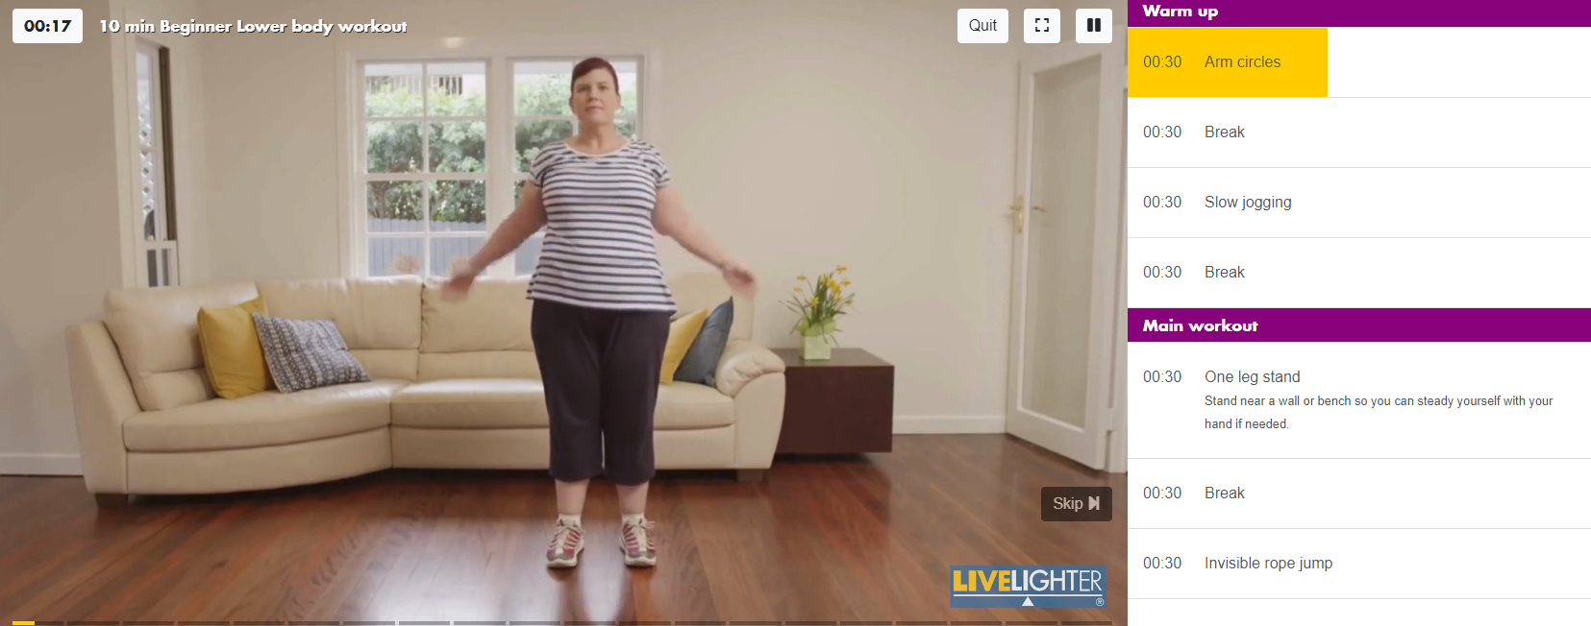
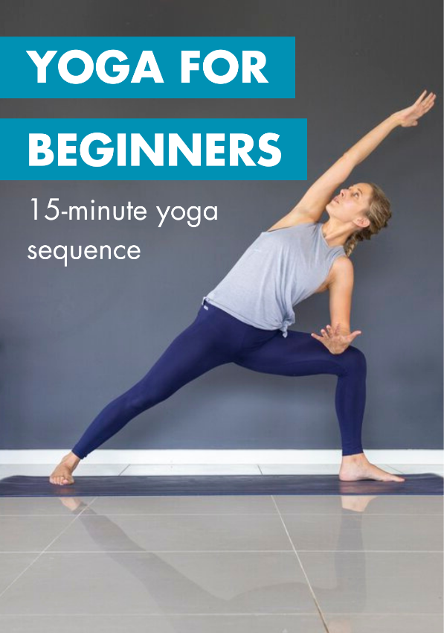
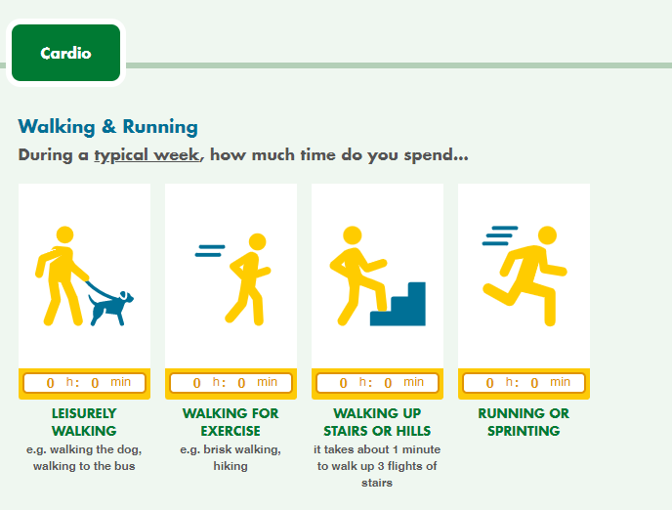
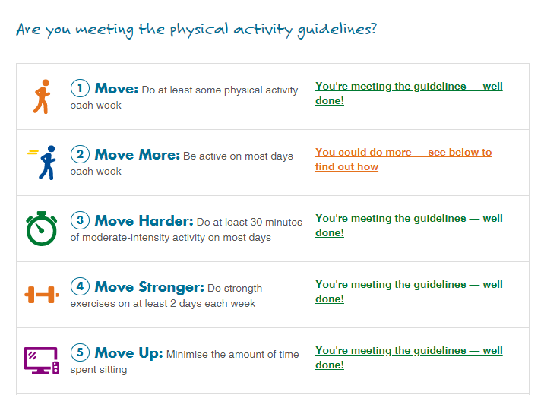
Free LiveLighter tools and resources
MY WORKOUT
BUILDER
Notes:
Visit the LiveLighter website for more tips, resources and interactive tools

Slide 21
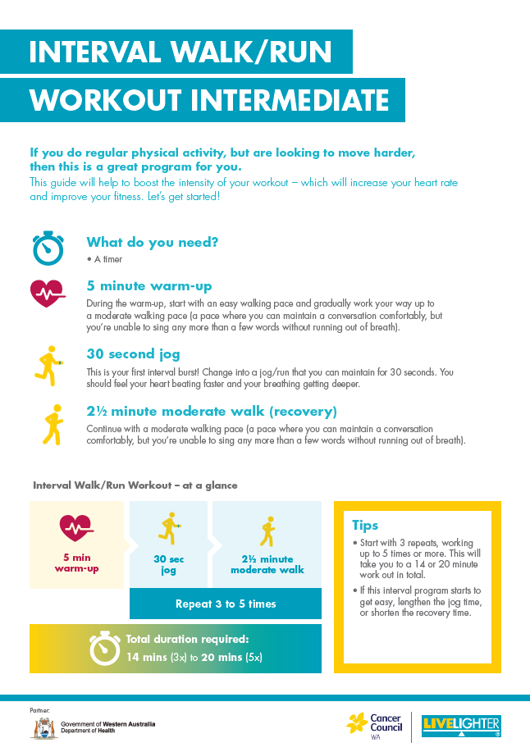
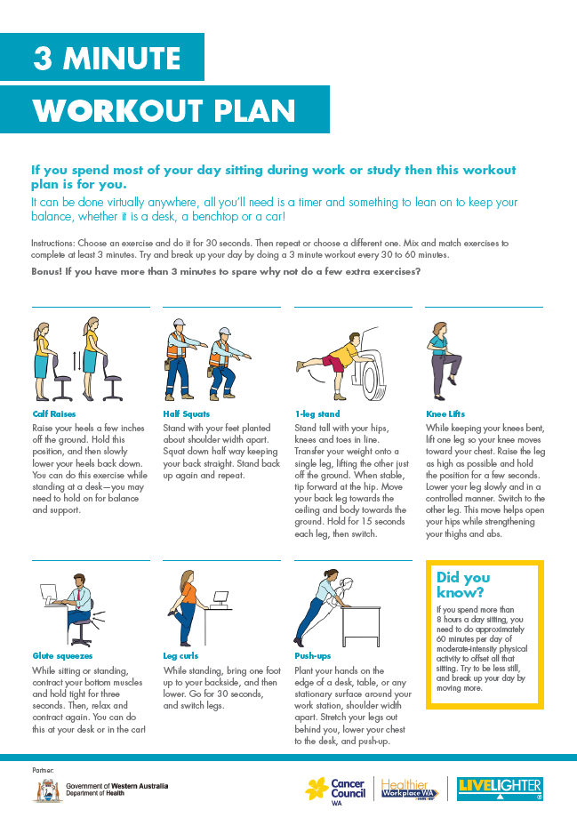
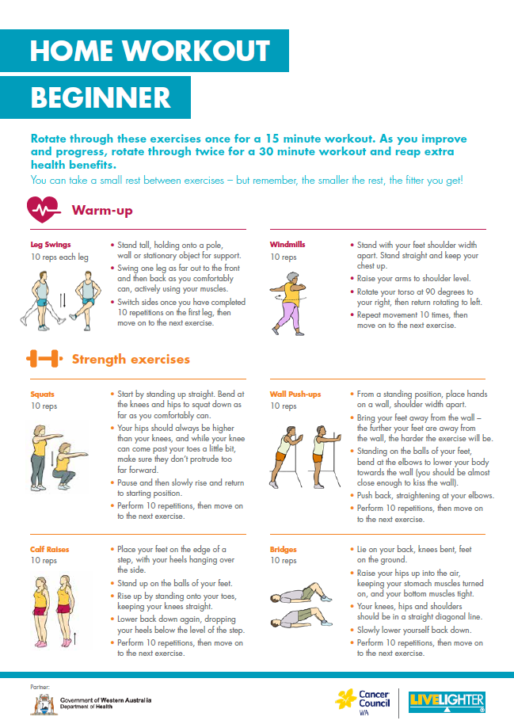
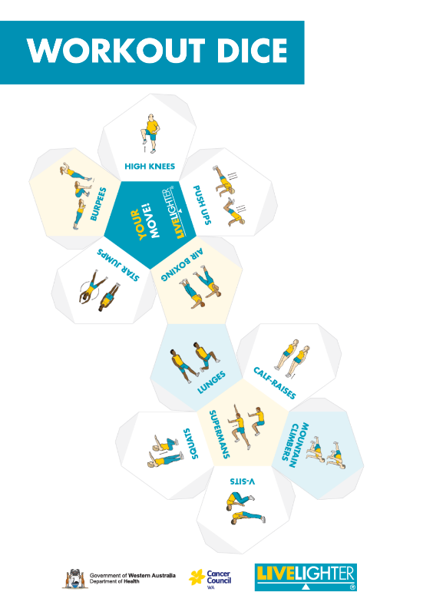
Free LiveLighter tools and resources

Slide 22
Take home points
Being physically active is important for all aspects of health
Doing some is better than none, and more is better
There are lots of resources available on the LiveLighter website to help get you moving

Slide 23
Questions?

