Slide 1
Shop Smart Tips and tricks for eating well on a budget
Name
Role and/or Qualifications
Organisation
On behalf of the LiveLighter team at Cancer Council WA
Notes:
Notes to presenter:
If you are in Western Australia or Victoria, you can order resources to give out to attendees. Please allow 3 weeks for delivery. Order using the online form - https://livelighter.com.au/order/resources
You can also download and print resources from this page - https://livelighter.com.au/toolbox/download-resources
The following resources are particularly relevant to this presentation
Label reading wallet card - https://cdn.livelighter.com.au//assets/resource/wallet-card/may-2021-livelighter-label-reading-wallet-card.pdf
Shop Smart booklet - https://livelightersyd.s3.ap-southeast-2.amazonaws.com/assets/resource/booklet/ll-shop-smart.pdf
Eat Smart booklet - https://livelightersyd.s3.ap-southeast-2.amazonaws.com/assets/resource/booklet/ll-eat-smart.pdf
Take away the takeaway recipe booklet - https://cdn.livelighter.com.au//assets/resource/booklet/2021-03-09-takeaway.pdf
You can use real food packages for the label reading activity on slides 14-19 to make the presentation more interactive. Breakfast cereals, crackers or muesli bars all work well.

Slide 2
Acknowledgement of Country
I begin today by acknowledging the Traditional Custodians of the land on which we meet today, and pay my respects to their Elders past and present.
I extend that respect to Aboriginal and Torres Strait Islander peoples here today.
Notes:
Please include the name of the people on whose land you are gathered to the slide if this is known.
Find out what country you are on here: https://aiatsis.gov.au/whose-country-am-I

Slide 3
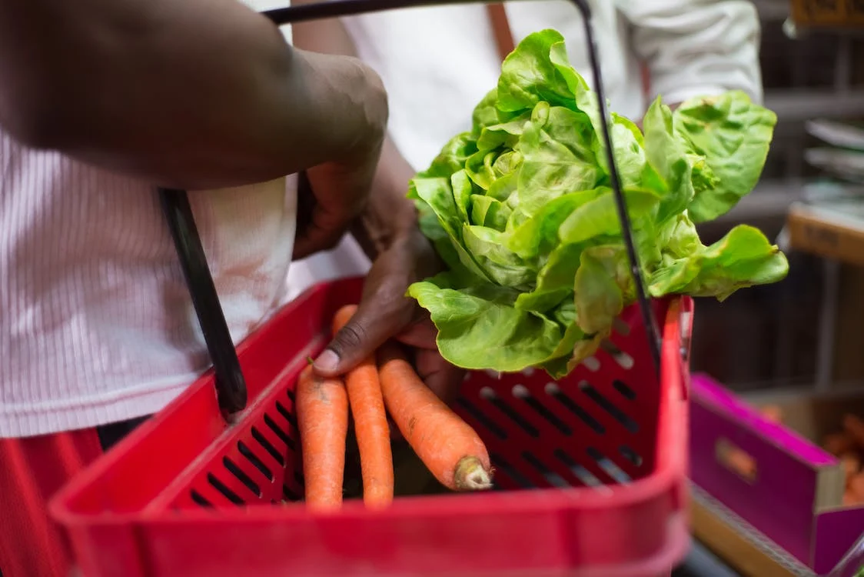
On the menu today
Healthy trolley guide
Interpreting food labels
Sneaky food marketing tricks
Tips to eat well on a budget
Free tools and resources
Photo by Kampus Production from Pexels: https://www.pexels.com/photo/person-carrying-a-red-plastic-basket-8475111/

Slide 4
Filling your trolley with healthy and affordable foods

Slide 5
Filling your trolley with healthy foods
Notes:
Here is a visual guide to filling your trolley with healthy foods in a way that makes the most of your food dollars.

Slide 6
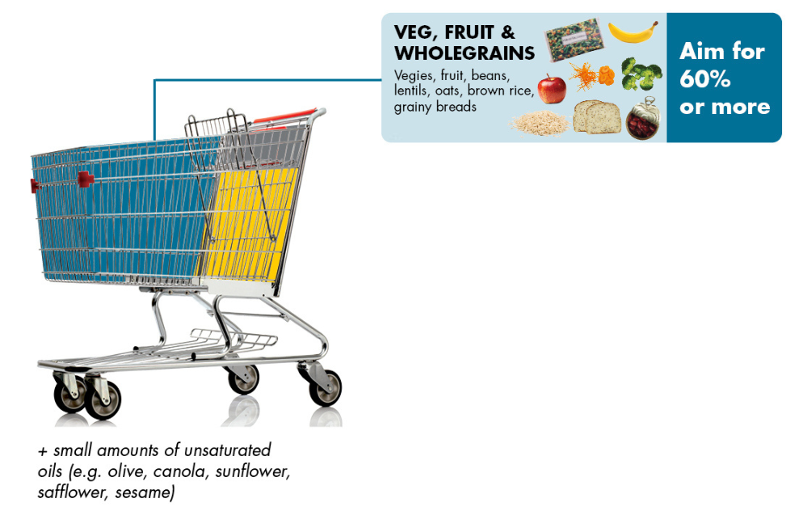
Filling your trolley with healthy foods
Notes:
Vegies, fruit, beans, lentils and wholegrains are healthy everyday foods that are usually cheaper than other foods like meat and dairy. Aim for 60% or more of these foods in your trolley.
Wholegrains include foods like oats, brown rice and grainy bread.

Slide 7
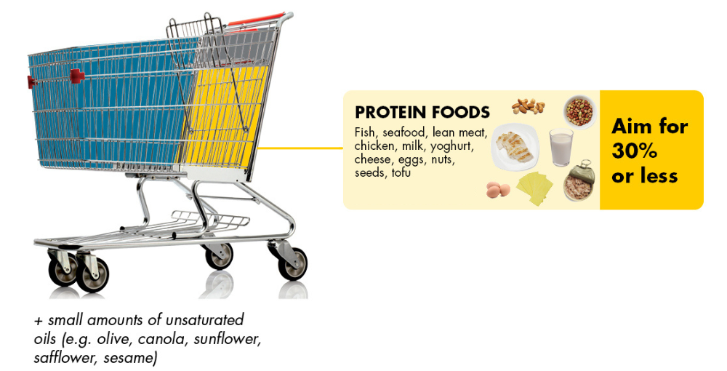
Filling your trolley with healthy foods
Notes:
Protein foods include things like fish, seafood, lean meat, chicken, milk, yoghurt, cheese, eggs, nuts, seeds and tofu.
While these are healthy foods to eat everyday, they’re usually a bit more expensive and we need a bit less of them in our diet.
Aim to fill around 30% of your trolley with these foods.

Slide 8
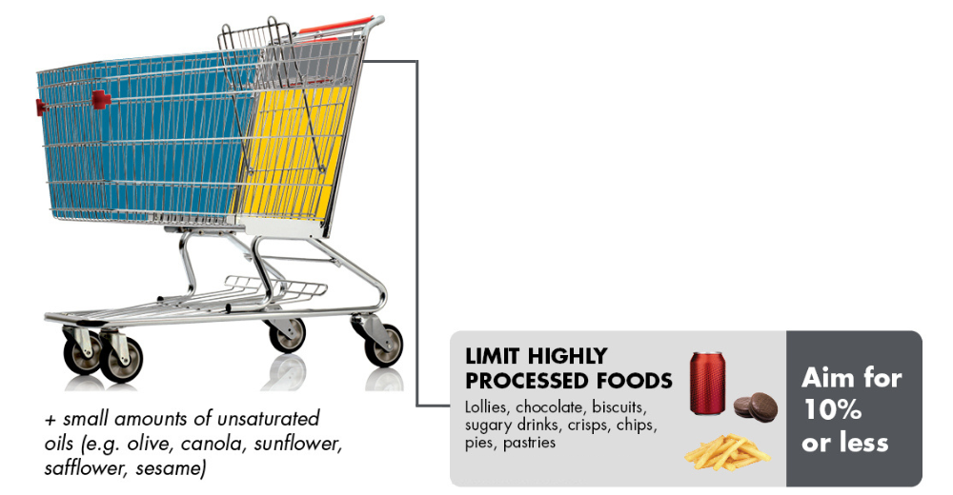
Filling your trolley with healthy foods
Notes:
Highly processed food includes sugary drinks and junk foods like lollies, chocolate, biscuits, crisps, chips, pies and pastries.
These foods are expensive and don’t provide any of the good stuff our bodies need.
Aim to fill no more than 10% of your trolley with these foods.

Slide 9
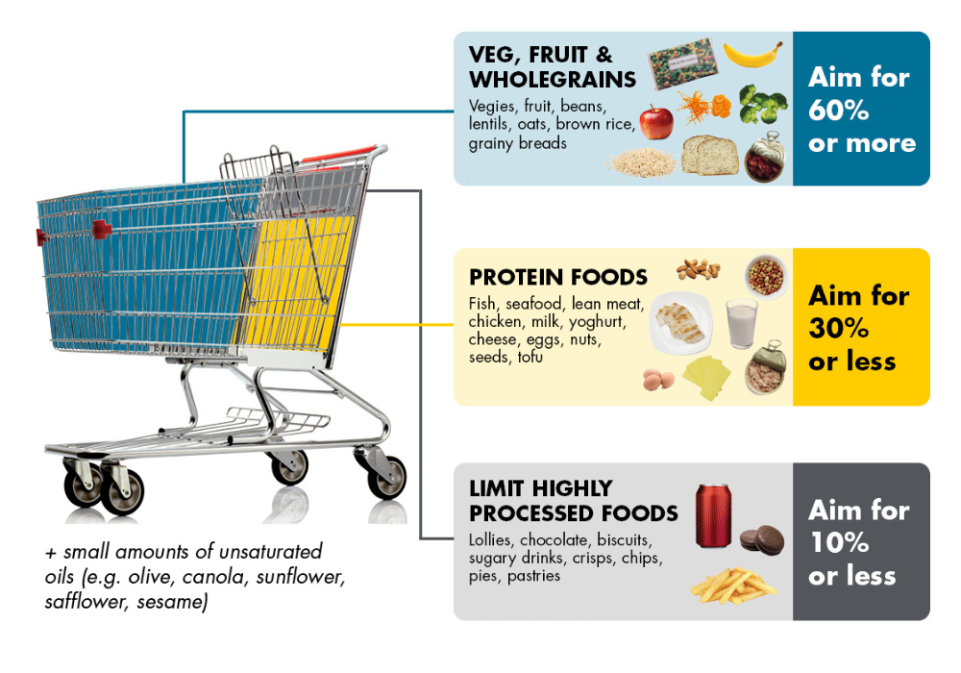
Filling your trolley with healthy foods
Notes:
The healthiest foods are everyday staples without fancy packaging or heavy marketing.
Including healthy foods like oats, seasonal fruit and veg, frozen veg, tinned beans and brown rice in your weekly shop will help you stick to your food budget, and fill plates and tummies too.

Slide 10
Understanding food labels
Notes:
Food manufacturers often use clever marketing and sneaky tactics to make it difficult to figure out if a packaged food is actually a nutritious option.
In the next section we’re going to look at how to interpret the nutrition information found on food packages.

Slide 11
It’s all about the label
Notes:
Most packaged foods have a nutrition panel and an ingredients list.
Here are some things to look out for.

Slide 12
The ingredients list
Ingredients are listed from MOST to LEAST by weight
Short lists are good!
Watch out for sneaky names for fat, sugar and salt
Sugar | Salt | Fat
Agave nectar Brown/cane/raw sugar Corn syrup Dextrose Fructose Fruit juice/puree concentrate Glucose Golden syrup Honey Invert sugar Malt Maple syrup Molasses Rice syrup Sucrose | Celery salt Flavour enhancer 621 (MSG) Pink salt Meat/vegetable/yeast extract Rock salt Sea salt Sodium Soy sauce Stock Table salt | Butter Cocoa butter Coconut oil Copha Cream Ghee Hydrogenated oil Lard Margarine Oils (of any kind) Shortening Suet Tallow
Notes:
Ingredients are listed in order according to how much of them is in the packet.
As a general rule, short lists are good as it usually means the food is less processed.
Sugar, fat and salt often have different names on the ingredients list. Watch out for the ones listed on the slide.

Slide 13
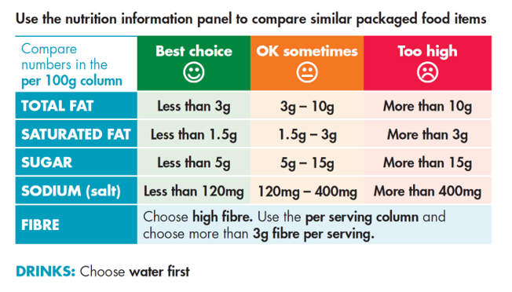
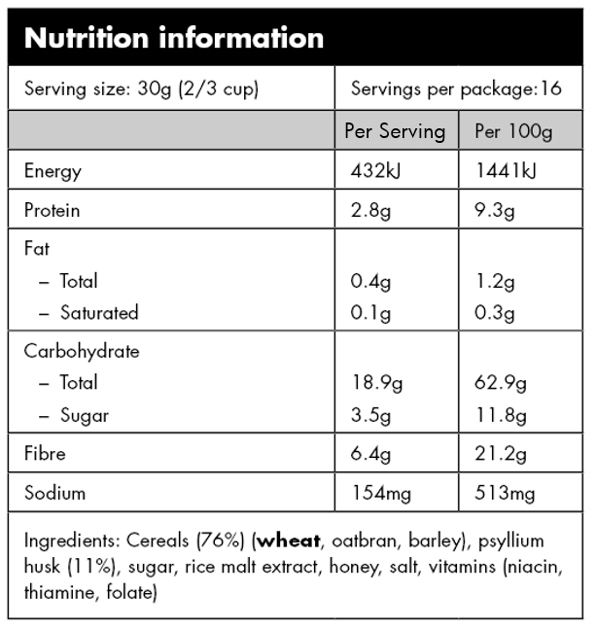
Interpreting food labels
Notes:
In Australia, most packaged foods are required to display a nutrition information panel. The panel shows the amount of nutrients ‘per serving’ and ‘per 100g’.
The label reading card on the right is a great tool to use to interpret nutrition panels and choose the best option for you. These numbers are not the only important thing, but they’re a good place to start.
Here’s how to use the label reading card:
Find the ‘per 100g’ column on the nutrition panel on the food package and compare this against our guide.
If the 100g value for saturated fat, total fat, sugar and salt falls in the green column, it’s a better option than a product that falls in the orange or red column.
Fibre is something we want more of so look for products with more than 3g per serving.
Note to presenter: You can use real food packages for the interactive activity on the next few slides. Breakfast cereals, crackers or muesli bars all work well. If you have ordered label reading cards from the LiveLighter website, you can give these out at this point in the presentation.

Slide 14
Interpreting food labels
Notes:
Let’s look at the sugar content of the product shown on the slide and see how it compares against the label reading card.
First we make sure we’re looking at the ‘per 100g’ column and then we go down to sugar.
This product has 11.8g of sugar per 100g, so what traffic light colour would we give it?
Note to presenter: If appropriate, give the audience a few minutes to determine the answer.

Slide 15
Interpreting food labels
Notes:
This product gets an ‘orange’ rating for sugar, which means it’s okay to have sometimes.

Slide 16
Interpreting food labels
Notes:
Now let’s look at the sodium (salt) content of the product shown on the slide and see how it compares against the label reading card.
First we make sure we’re looking at the ‘per 100g’ column and then we go down to sodium.
This product has 513mg of salt per 100g, so what traffic light colour would we give it?
Note to presenter: If appropriate, give the audience a few minutes to determine the answer.

Slide 17
Interpreting food labels
Notes:
This product gets a ‘red’ rating for salt, which means it’s too high.

Slide 18
Interpreting food labels
Notes:
Now let’s look at the fibre content of the product shown on the slide and see how it compares against the label reading card.
Fibre is a little different because we look at the “per serving” column rather than the “per 100g” column. Go down the column to find fibre.
This product has 6.4g of fibre per serving, so does this product get a tick or a cross for fibre according to the guidelines?
Note to presenter: If appropriate, give the audience a few minutes to determine the answer.

Slide 19
Interpreting food labels
Notes:
This product gets a ‘green’ rating for fibre, which means it is relatively high in fibre.

Slide 20
Interpreting food labels
Notes:
Many food items will have different nutrients fall into different colour categories. As a rough guide, aim to have at least two nutrients in the green column and no nutrients in the red column.
Whole foods, foods without a label and foods with only a few ingredients are usually cheaper and better for our health. This includes fruits and vegetables, nuts and seeds, legumes, eggs, fish, red meat, chicken, dairy foods and wholegrains.

Slide 21
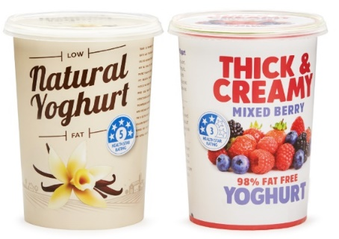
Health Star Rating
A quick way of checking if a food is a healthy choice
Healthier products earn more stars
Should be used to compare similar foods
e.g. two breakfast cereals
Should NOT be used to compare foods in different categories
e.g. a breakfast cereal and a yoghurt
Currently voluntary
Notes:
The Health Star Rating looks at the overall healthiness of a product and gives it a score out of 5 stars. More stars are given to more nutritious foods.
The rating is made to compare similar foods. For example, comparing different flavours of muesli bar or different brands of yoghurt. Use the stars to help choose which yoghurt to buy, rather than to decide whether to buy a yoghurt or a muesli bar.
The star ratings are only on packet foods. So many foods that deserve 5 stars (like fresh fruit and vegies) don’t show them.
Food companies sometimes only put them on their healthier items or flavours. Some food companies don’t use them at all, but this doesn’t necessarily mean they’re not a healthy option.

Slide 22
Stretch break!
Photo by Richard Verbeek from Pexels: https://www.pexels.com/photo/tiger-in-shallow-photo-572861/

Slide 23
Marketing tricks to watch out for
Notes:
Food manufacturers know that consumers want to eat better, and use a range of marketing techniques to make foods look and sound healthier than they actually are.
Here are some tricks to look out for.

Slide 24
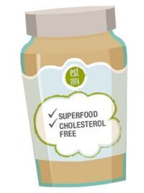
1. Buzzwords
Many products carry claims like ‘natural’, ‘organic’, ‘lite/light’, ‘clean’, ‘fresh’, ‘wholesome’, ‘superfood’, ‘baked not fried’ or ‘sweetened with fruit’
These claims can make a product sound healthy but are usually meaningless
Notes:
Many products carry claims like ‘natural’, ‘organic’, ‘lite/light’, ‘clean’, ‘fresh’, ‘wholesome’, ‘superfood’, ‘baked not fried’ or ‘sweetened with fruit’.
The use of health buzzwords on a food package gives the food a ‘health halo’ that makes us see the product as healthier, even if it isn’t healthy at all.
For example, a fruit bar may sound healthy as it claims to be ‘lunchbox friendly’, contain ‘superfoods’ and have ‘no artificial stuff’ even though it is 50% sugar!

Slide 25
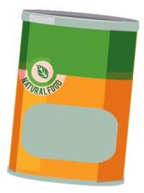
2. Package trickery
Implying a food is healthy without actually making a claim
Examples - Brown paper packaging, green leaves, muted colours, nature landscapes, images of fruits and vegetables, minimalist designs and earthy fonts
Notes:
Manufacturers may use strategies to suggest a food is healthy and ‘wholesome’ without the manufacturer having to actually make this claim (or back it up).
Examples - Brown paper packaging, green leaves, muted colours, nature landscapes, images of fruits and vegetables, minimalist designs and earthy fonts

Slide 26
3. ‘Free from’ claims
‘Free from’ claims can be used to hide less palatable facts about the product
Examples - ‘gluten-free’, ‘fat-free’, ‘refined sugar-free’ or ‘cholesterol-free’
Notes:
‘Free from’ claims like ‘gluten-free’, ‘fat-free’ and ‘refined sugar-free’ can be used to hide less palatable facts about the product.
For example, lollies may make a claim that they are 99% fat-free. That’s true. They are also almost 100% sugar!
Crackers may be marketed as gluten-free but can still be highly processed and packed with saturated fat and salt.
Note to presenter: Option to ask the audience if they can think of any other ways that food manufacturers try to make us think that a food is healthier than it actually is.

Slide 27
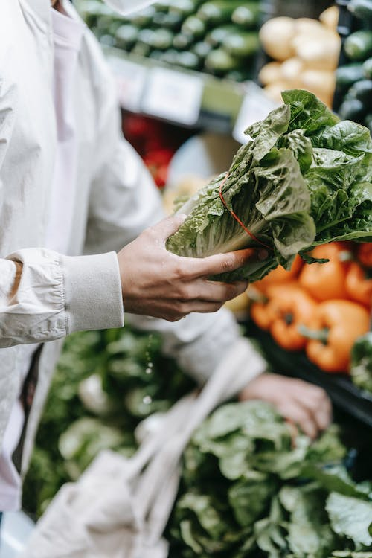
Take homes
Look at which ingredients are listed first
Be wary of nutrition claims and package trickery
Foods without labels are often the healthiest!
Photo by Michael Burrows from Pexels: https://www.pexels.com/photo/anonymous-customer-picking-greens-in-supermarket-7129126/

Slide 28
Tips to eat well on a budget

Slide 29
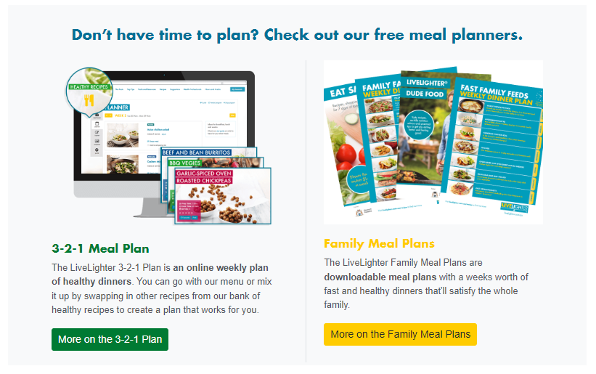
1. Plan your meals
Set aside some time each week to brainstorm meals
Make a shopping list
Stick to the list
Notes:
Planning meals can save time and money and reduce stress. It can also mean being less tempted to buy takeout during the week when your resources are lower.
Step 1: Set aside some time each week to brainstorm meals
Use tried and tested recipes, or find new recipes online or in recipe books and magazines. If you have anything in your fridge or freezer that needs to be eaten soon, plan your next few meals around these. LiveLighter has over 400 healthy recipes on their website.
Step 2: Make a shopping list
Check what ingredients you already have in your pantry, fridge and freezer and write down any extras you need from your meal plan, plus other items like snacks and breakfast foods.
Step 3: Stick to the list!
Following through with the plan will reduce impulse purchases and keep your costs down.
Don’t have time to plan? LiveLighter have a number of different meal plans you can access that are absolutely free to use. Check them out at livelighter.com.au

Slide 30
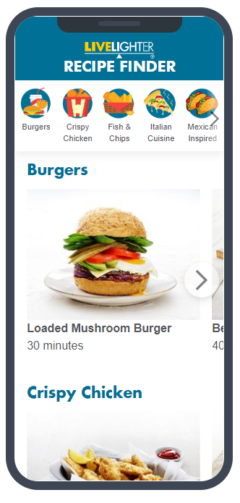
2. Takeaway the take away
Takeaway meals are often loaded with sugar, salt and saturated fat
They also tend to be low in the essential nutrients we need
Notes:
Food you make at home is often cheaper and healthier than highly processed packaged and takeaway foods.
Find healthy versions of your favourite takeaway foods on the LiveLighter recipe page.
Note to presenter: If you have ordered the takeaway recipe booklet to give away you can mention this to attendees at this point.

Slide 31
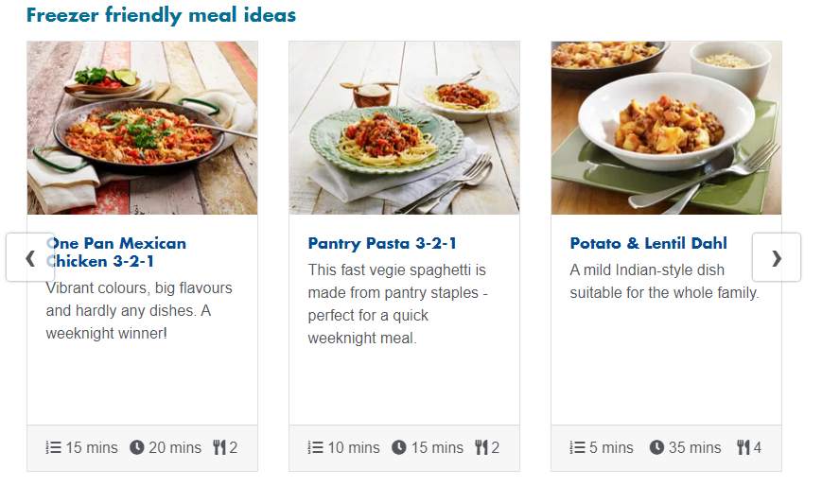
3. Healthy home cooking
Bulk up meals with frozen vegies
Swap like a pro
Bulk cook and freeze in portions
Notes:
Bulk up meals with frozen veg. They’re pre-cut, affordable, have a long shelf life and are just as nutritious as fresh.
Swap like a pro. Don’t feel like you need to follow recipes exactly. Make swaps to use up ingredients you already have and avoid an extra trip to the shops.
Cooking in bulk and freezing meals is a great way to save time and make sure there’s always a healthy meal on time for those days that you don’t feel like cooking.

Slide 32
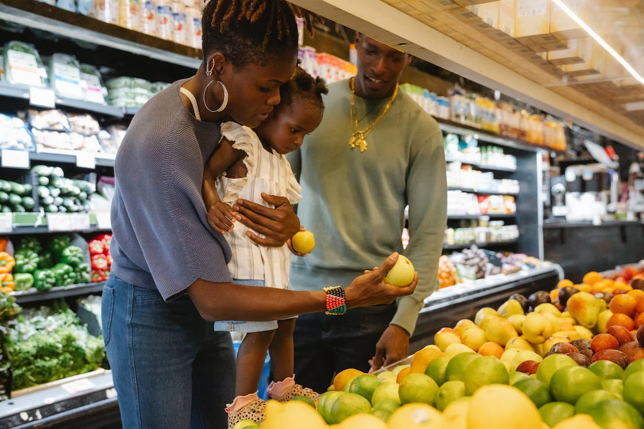
4. At the supermarket
Don’t shop hungry
Steer clear of the sugary drink and chocolate aisles
Try out the home brands
Reroute pester power
Photo by Greta Hoffman from Pexels: https://www.pexels.com/photo/a-family-buying-groceries-in-a-supermarket-9706134/
Notes:
Hunger can drive us to buy foods that are higher in fat and sugar and are more highly processed.
Steering clear of the sugary drink and chocolate aisles can also make it easier to keep these out of the trolley.
Home brands are often much cheaper and are just as good quality as branded versions. This is especially true for products with only a few ingredients, like tinned tomatoes or rolled oats.
Overcome pester power by giving kids a mission to collect a specific item while grocery shopping. Busy kids have less time to nag!

Slide 33
Unit pricing
Helps us compare the cost of products in different sized packets
Can be written as $/kg, $/100g, $/L, …
Notes:
Unit pricing helps us compare the cost of products when they come in different sized packets. It helps us tell which items are the best value (not just the cheapest).
Unit prices can be written as dollars per kilo, per 100g, per roll, per litre, etc.
In the example on the slide, brand two has a smaller ticket price, but brand one is better value.
Before buying the bigger package, consider if you’ll be able to use it up, or if not, if you’re able to store it for later.
Fresh produce is perishable so buying smaller amounts, more often, can reduce waste if it means you’re actually using it all up.

Slide 34
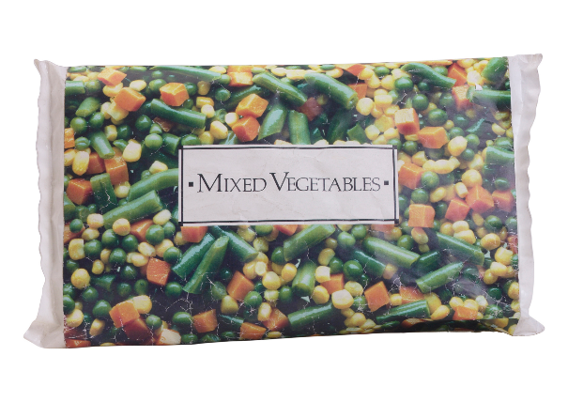
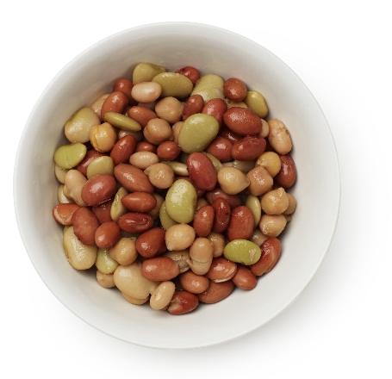
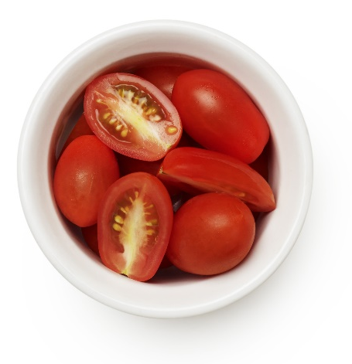
Is fresh always best?
Canned, frozen and dried fruit and vegetables have a long shelf life and are often cheaper than fresh.
They are nutritionally very similar to fresh, making them a great budget-friendly option.
Go for fresh produce that is in season
Notes:
Fresh fruit and veg are nutritious and tasty, but how do they compare to alternatives?
Canned, frozen and dried fruit and vegetables have a much longer shelf life and are often cheaper than fresh produce. They can be bought in larger quantities when they are on sale since they last much longer.
They also are often pre-chopped which can reduce how long it takes to prepare meals.
Scientific studies have found that the vitamin content of frozen fruit and veg is comparable to fresh, and in some cases even higher! Once picked, fruit and vegies grown for freezing and canning are processed immediately, sealing in nutrients.
When choosing fresh fruit and vegies, go for those that are in season for the best taste and best value. A good rule of thumb is that if it's locally grown and on special, it's probably in season.

Slide 35
What are your favourite tips for eating well on a budget?
Notes:
Note to presenter: This is an opportunity for participants to share the strategies they use to manage their food bill.

Slide 36
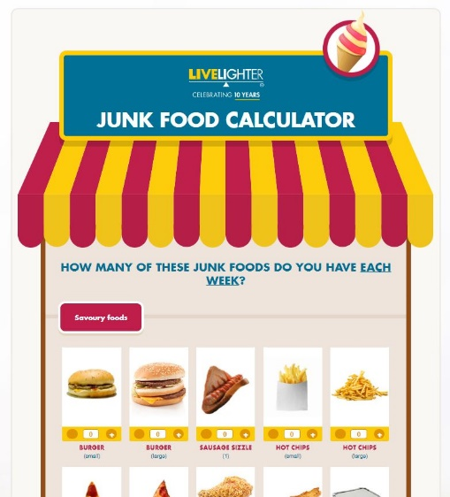
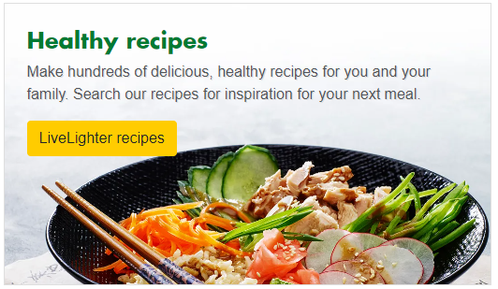
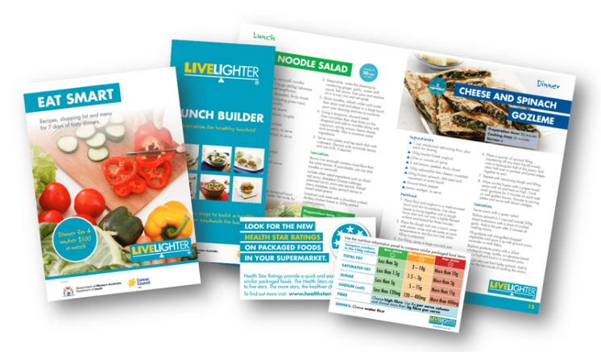
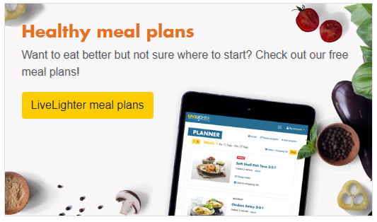
Free LiveLighter tools and resources
Notes:
Visit the LiveLighter website for more tips, resources and interactive tools

Slide 37
Questions?

