Slide 1
Not so sweet on the sweet stuff Hidden sugars and how to avoid them
Name
Role and Qualifications
Organisation
On behalf of the LiveLighter team at Cancer Council WA
Notes:
Notes to presenter:
If you are in Western Australia or Victoria, you can order resources to give out to attendees. Please allow 3 weeks for delivery. Order here using the online form - https://livelighter.com.au/order/resources
You can also download and print resources from this page - https://livelighter.com.au/toolbox/download-resources
The following resources are particularly relevant to this presentation
https://cdn.livelighter.com.au/assets/resource/recipe-card/2020-11-5-ll-drink-recipe-cards.pdf
https://cdn.livelighter.com.au/assets/resource/poster/ll-sugary-drinks-a3-poster-web.pdf
https://cdn.livelighter.com.au/assets/resource/poster/ll-poster---am-i-drinking-enough-water-(ll3004d).pdf
https://cdn.livelighter.com.au/assets/resource/factsheet/ll-factsheet-cut-back-on-sugar-(ll3020d).pdf
https://cdn.livelighter.com.au/assets/resource/factsheet/easy-to-read-factsheets/ll-factsheet-cut-back-on-sugar-easy-read-(ll3034d).pdf
https://cdn.livelighter.com.au/assets/resource/factsheet/ll-factsheet-avoid-sugary-drinks-(ll3027d).pdf
https://cdn.livelighter.com.au/assets/resource/factsheet/easy-to-read-factsheets/ll-factsheet-avoid-sugary-drinks-easy-read-(ll3031d).pdf

Slide 2
Acknowledgement of country
I begin by acknowledging the Traditional Custodians of the land on which we meet today, and pay my respects to their Elders past and present.
I extend that respect to Aboriginal and Torres Strait Islander peoples here today.
Notes:
Please add the name of the people on whose land you are gathered to the slide if this is known.
Find out what country you are on here: https://aiatsis.gov.au/whose-country-am-I

Slide 3
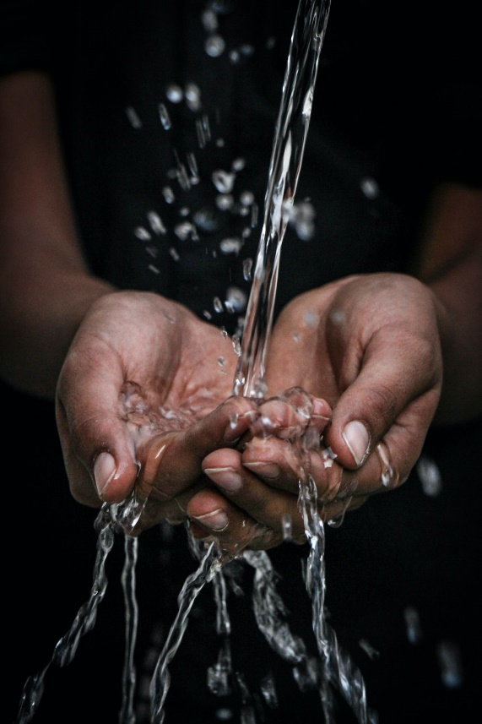
On the menu today
Natural vs added sugar
Different names for sugar and how to spot them
What are sugary drinks
The sneaky sugar in “healthy” drinks
How to tell if you’re drinking enough water
Photo by mrjn Photography on Unsplash

Slide 4
Where do we find sugar?
Natural sugars
Added sugars
Found in fruit and milk products
Found in highly processed foods and drinks
Notes:
We can split sugars into two groups – those that occur naturally in food and those that are added.
Fruit, milk, yoghurt and cheese contain naturally occurring sugars. These foods also have nutrients like protein, calcium, fibre, vitamins and minerals. The sugars found naturally in fruit and plain milk and yoghurt are NOT bad for health and these foods are good options to have every day.
Ultra-processed foods and drinks contain added sugars. These foods are high in energy (kilojoules) and don't have the nutrients our body needs. While it’s fine to have these foods occasionally, it’s better for our health not to have them every day.

Slide 5
Sugar and health
Sugary foods and drinks are heavily marketed and available everywhere, making it easy to have too much
Having too much added sugar is linked to:
Tooth decay
Weight gain - which increases the risk of heart disease, type 2 diabetes, fatty liver disease and some cancers
Notes:
Aussies are bombarded with a huge amount of marketing for sugary foods and drinks every day. What these companies don’t advertise is the impact that having too much sugar can have on our health.
Having too much added sugar, particularly when it’s from sugary drinks, can cause tooth decay and contribute to weight gain, increasing the risk of heart disease, type 2 diabetes, fatty liver disease and 13 types of cancer.

Slide 6
Other names for sugar…
Barley malt extract
Brown rice syrup
Brown sugar
Cane sugar
Corn syrup
Fruit juice/puree concentrate
Glucose
Golden syrup
High fructose corn syrup
Honey
Invert sugar
Malt
Maple syrup
Molasses
Raw sugar
Rice malt syrup
Rice syrup
Sucrose
Photo by Suzy Hazelwood from Pexels: https://www.pexels.com/photo/close-up-photo-of-sugar-cubes-in-glass-jar-2523650/
Notes:
Sugar may be hidden on the ingredients list under a different name. Food marketers know that people are trying to eat less sugar and so they use sneaky names for sugar to make us think that a product is healthier than it actually is.
Ingredients like fruit juice concentrate, maple syrup, honey and rice malt syrup are all just different names for sugar!

Slide 7
Spot the added sugars!
Ingredients: Wheat Flour, Apple & Raspberry Paste (30%) [Fruit Puree Concentrate (42%) (Apple (87%), Raspberry (13%)), Sugar, Glucose, Humectant (Glycerol), Wheat Fibre, Citrus Fibre, Acid (Citric), Natural Flavour, Natural Colour (163)], Dextrose, Water, Wholegrain Oat Flour (5%), Butter (Contains Milk), Sugar, Whey Powder (From Milk), Humectant (Glycerol), Canola Oil, Raising Agent (500, 450, 341, 541), Whey Protein Concentrate (From Milk), Natural Flavour, Emulsifier (Soy Lecithin), Caramelised Sugar.
Notes:
This is a real food product for a snack bar aimed at young children 12 months and over.
How many different names for sugar can you see listed in the ingredients list?

Slide 8
Spot the added sugars!
Ingredients: Wheat Flour, Apple & Raspberry Paste (30%) [Fruit Puree Concentrate (42%) (Apple (87%), Raspberry (13%)), Sugar, Glucose, Humectant (Glycerol), Wheat Fibre, Citrus Fibre, Acid (Citric), Natural Flavour, Natural Colour (163)], Dextrose, Water, Wholegrain Oat Flour (5%), Butter (Contains Milk), Sugar, Whey Powder (From Milk), Humectant (Glycerol), Canola Oil, Raising Agent (500, 450, 341, 541), Whey Protein Concentrate (From Milk), Natural Flavour, Emulsifier (Soy Lecithin), Caramelised Sugar.

Slide 9
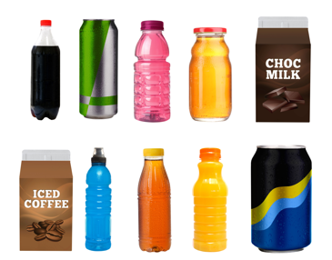
What are sugary drinks?
Notes:
Sugary drinks are the biggest source of added sugar in Aussie diets.
While many people will think of soft drink when they think of sugary drinks, they comes in lots of other forms. Examples include:
Sport drinks
Energy drinks
Sweetened ice tea
Fruit drinks
Slushies
Flavoured milk
100% fruit juice if quantities are greater than 125ml (1/2 cup) – this is due to the high amount of sugar and energy it provides.

Slide 10
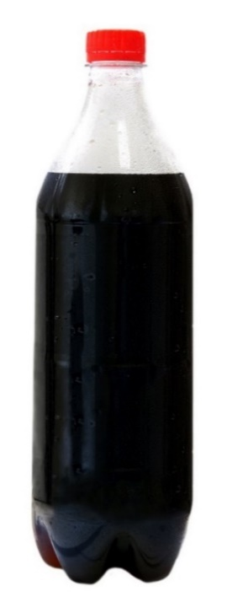
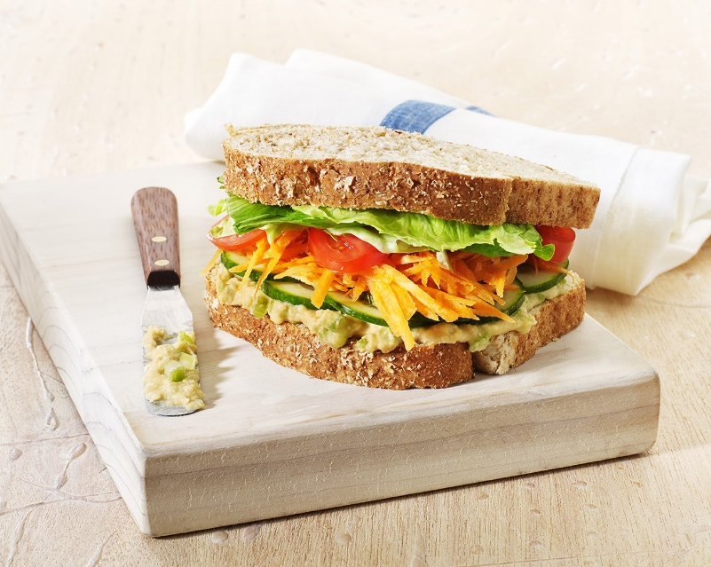
Sugary drinks contain more kilojoules than you might expect!
1044kJ
958kJ
Notes:
Sugary drinks can pack in as much energy (kilojoules or calories) as food, but they don’t fill you up or provide the nutrients that your body needs.
There’s around 1000 kilojoules in a regular 600mL cola, which is about the same as a salad sandwich!
The difference? The sandwich is a healthy option and would fill you up but the cola is packed with sugar without any of the good stuff that your body needs.

Slide 11
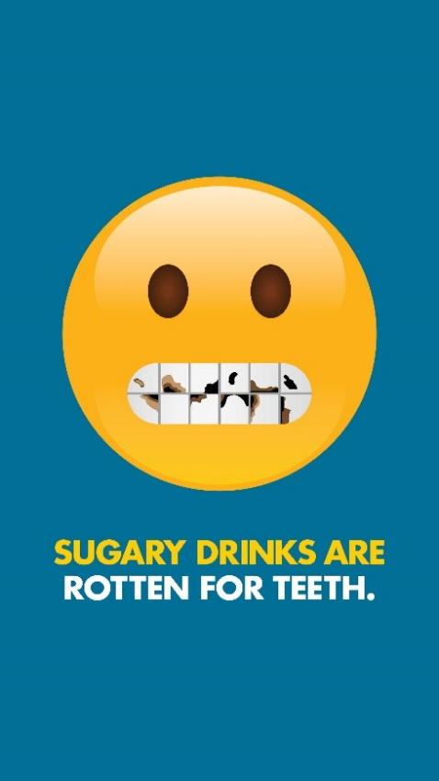
What happens to your teeth when you have a sugary drink?
Bacteria in your mouth break down the sugar into acids
The acid starts dissolving your tooth enamel
Each acid attack lasts for about 20 min
Every time you take a sip, the acid damage begins all over again
The regular loss of enamel can lead to cavities
Notes:
What happens to your teeth when you have a sugary drink?
Bacteria that are naturally present in your mouth break down the sugar in sugary drinks into acids.
The acid attacks the teeth, dissolving the outer surface of tooth enamel.
Each acid attack lasts for about 20 min. Every time you take a sip, the acid damage begins all over again.
The regular loss of enamel can lead to cavities which exposes the inner layers of the tooth. This makes teeth sensitive and painful.

Slide 12
How much sugar is in…
Notes:
Note to presenter: Images and answers are transitioned in slide show. You can ask participants to guess how many teaspoons of sugar are in each product before transitioning to the next slide.

Slide 13
How much sugar is in…
Notes:
Can you guess how much sugar is in a 600mL bottle of cola?

Slide 14
How much sugar is in…
Notes:
16 teaspoons!
What about in a 600mL bottle of sports drink?

Slide 15
How much sugar is in…
Notes:
9 teaspoons!
How much sugar do you think is in a 500mL bottle of iced tea?

Slide 16
How much sugar is in…
Notes:
8 teaspoons!
Ice tea might pretend to be as healthy as a nice warm cuppa, but these products are more like a “tea-flavoured” sugary drink

Slide 17
How much sugar is in…
Notes:
Can you guess how much sugar is in a 250mL can of energy drink (one of the small cans)?

Slide 18
How much sugar is in…
Notes:
7 teaspoons! The larger cans have double this amount.
How about in a 600mL carton of iced coffee?

Slide 19
How much sugar is in…
Notes:
Flavoured milks might seem like good option - it’s milk, and milk’s good for us, right? Well... yes and no.
Dairy milk contains naturally occurring sugar and healthy nutrients like protein and calcium. However, flavoured milks can also contain added sugars – up to 7 tsp in a large carton – so it’s better to choose plain milk to reap these benefits
Finally, how much sugar do you think there is in a mega slushie (1150mL)?

Slide 20
How much sugar is in…
Notes:
A whopping 20 teaspoons!
The World Health Organization recommends having no more than 6 teaspoons of added sugar each day. When you compare this against the amount of sugar you find in common sugary drinks, you can see why it’s not a good idea to have these every day.

Slide 21
Stretch break!
Photo by Tamba Budiarsana from Pexels: https://www.pexels.com/photo/stretching-white-cat-979247/

Slide 22
The sneaky sugar in “healthy” drinks
Notes:
While most of us might know that soft drinks are packed with sugar, what about some of the other drinks out there that market themselves as a better option?

Slide 23
Sports drinks
Sports drinks are full of sugar
A sports drink or electrolyte drink might be helpful if:
You’re doing more than 90 minutes of vigorous exercise, or
Losing a lot of fluid through vomiting, diarrhoea or heavy sweating
For most people, water is the best choice of drink, even if we’ve been active

Slide 24
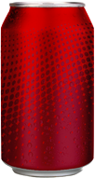
Diet drinks
Low in sugar and kilojoules
Research hasn't found them to be effective in managing weight
Regular consumption has been linked to a higher risk of type 2 diabetes
Diet drinks are highly acidic which makes them bad for our teeth

Slide 25
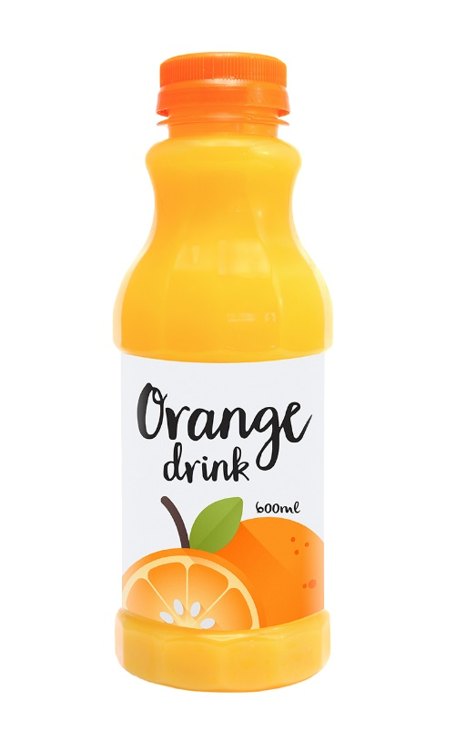
Fruit drinks
Many “fruit” drinks contain very little actual fruit juice
Usually have loads of added sugar

Slide 26
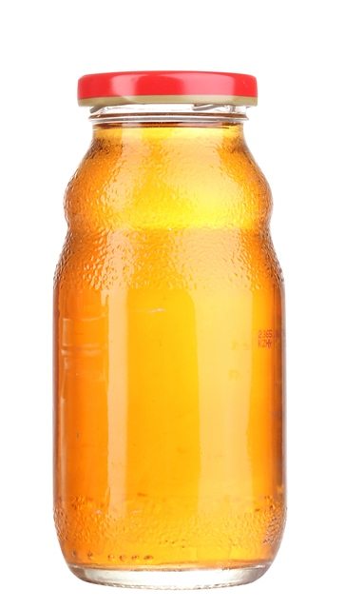
Fruit juice
When you juice a fruit, you squeeze all the sugar into a glass and throw away the fibre - that’s the best bit!
Small amounts of 100% fruit juice are okay to have occasionally
Notes:
Whole fruit is a great snack option. Yes, there’s sugar in fruit, but it’s bundled up with fibre, vitamins and antioxidants.
Small amount of juice = 125mL or half a cup

Slide 27
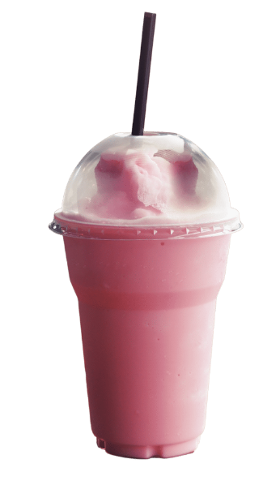
Smoothies
Smoothies use the whole fruit or veg (fibre, pulp and all) and plain milk so are usually a better choice than juice
Steer clear of added sweetening (e.g. honey, syrups) and ingredients like ice cream or sorbet
Watch out for take-away smoothies as they often come in huge portion sizes!

Slide 28
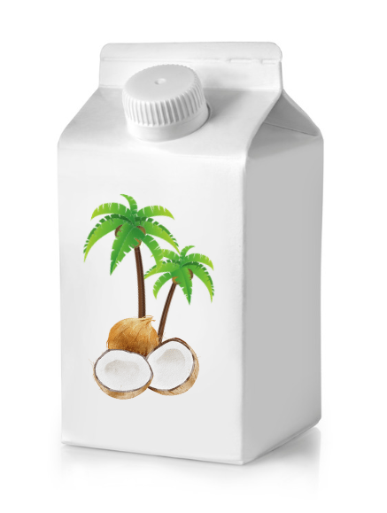
Coconut water
There are a lot of health claims made about coconut water that are not supported by the science
Straight coconut water has about half the sugar of a soft drink
Many packaged coconut waters also contain added sugar, so be sure to check the ingredients list

Slide 29
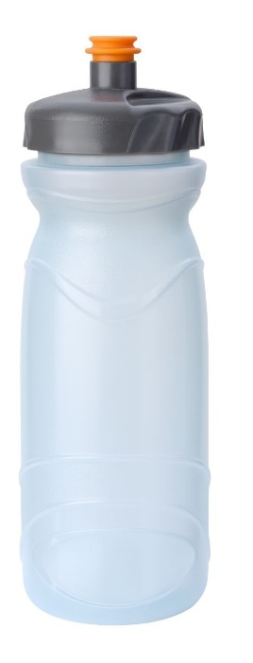
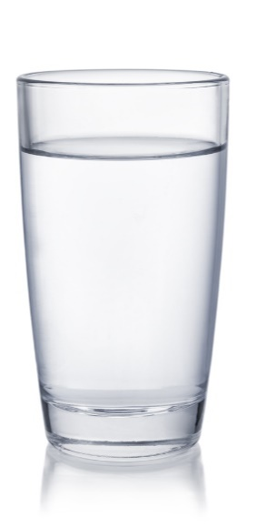
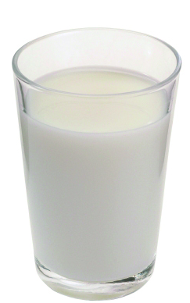
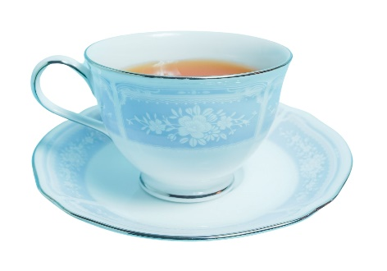
Healthy drinks
Notes:
Plain tap water is the best drink choice. It’s cheap, quenches your thirst and has no kilojoules.
Tip: Carry a refillable water bottle with you when you’re out and about - save money and reduce waste!
Other healthy drink options are sparkling water (add lemon slices, cut up strawberries, mint or cucumber slices for extra flavour), plain reduced-fat milk or tea or coffee without added sugar.
Low-sugar drinks are also an option if you’re not quite ready to make the switch to water. Flavoured water with minimal or no added sugar has less sugar than other sugary drinks.

Slide 30
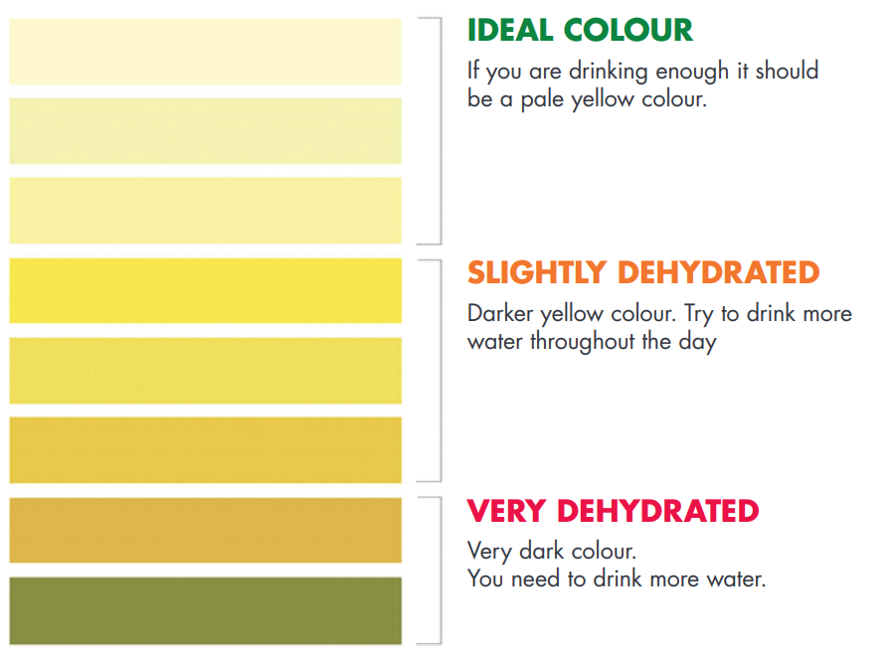
Am I drinking enough water?
Notes:
When we drink enough water our wee should be a pale yellow colour - like straw. Compare your urine colour to the chart on the slide.
What else can change the colour of my wee?
Some foods
Some medicines
Some vitamins
**This colour chart is for people with normal kidney function. These colours are a guide only. Check the colour of your wee over a week to see how much water your body needs.**

Slide 31
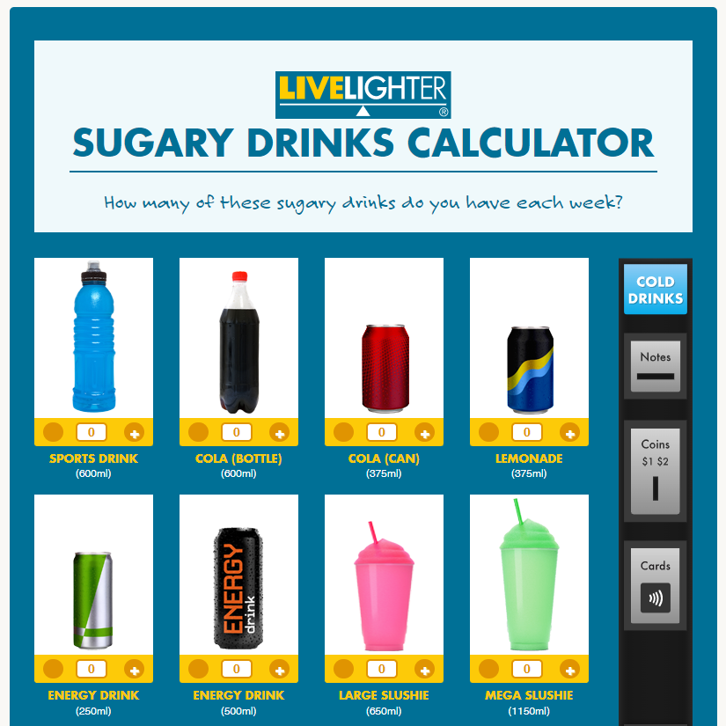
Sugary drinks calculator
Notes:
LiveLighter’s sugary drinks calculator is an online tool that allows you to calculate how much sugar and energy you are having from sugary drinks

Slide 32
Summary
Sugary drinks have lots of kilojoules and added sugars
Some sugary drinks have the same kilojoules as a small meal
Drinking sugary drinks increases your risk of weight gain, chronic diseases and tooth decay
Only have sugary drinks occasionally and in small amounts
Go for tap water as your drink of choice
Notes:
Sugary drinks are categorised as junk foods. They are not an essential part of our diets and should only be consumed occasionally and in small amounts.
Sugary drinks are high in energy (kilojoules) and added sugars and they lack nutritional value (for example, vitamins, minerals and fibre).

Slide 33
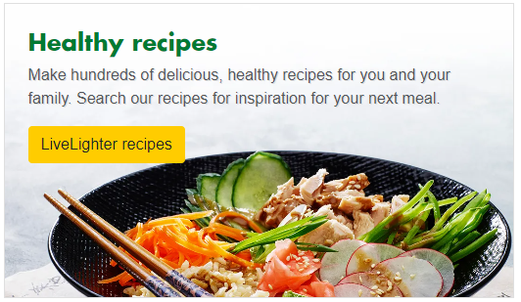
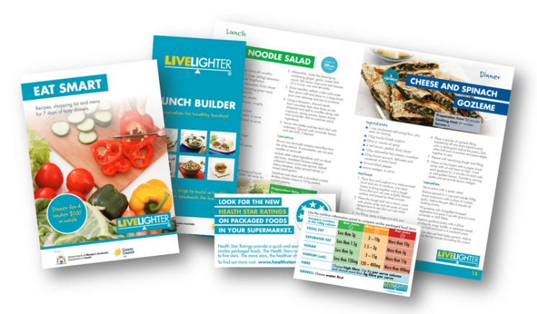
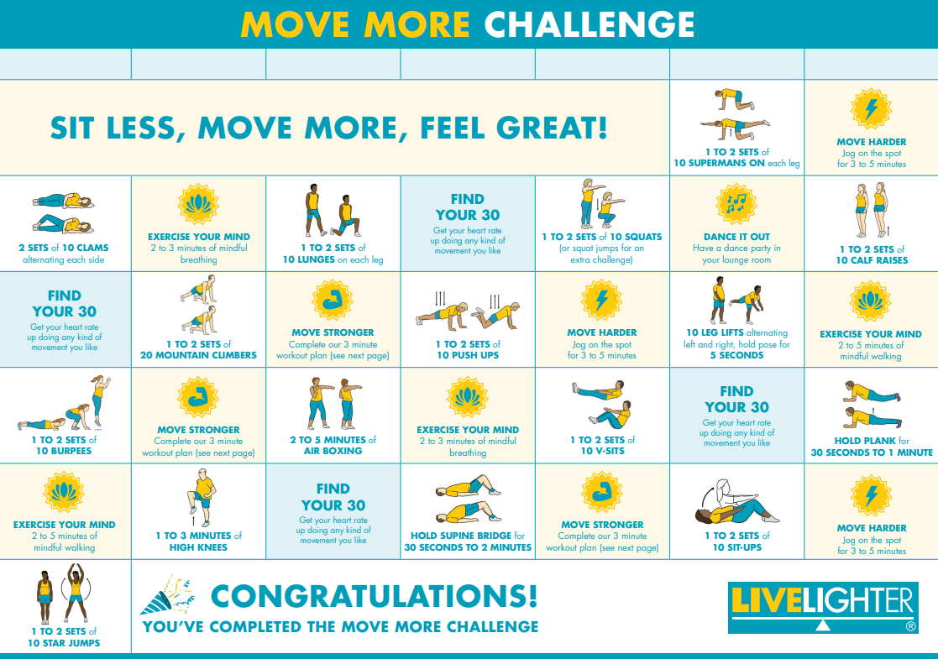
Free LiveLighter tools and resources
Notes:
Visit the LiveLighter website for more tips, resources and interactive tools

Slide 34
Questions?

